Slide 1

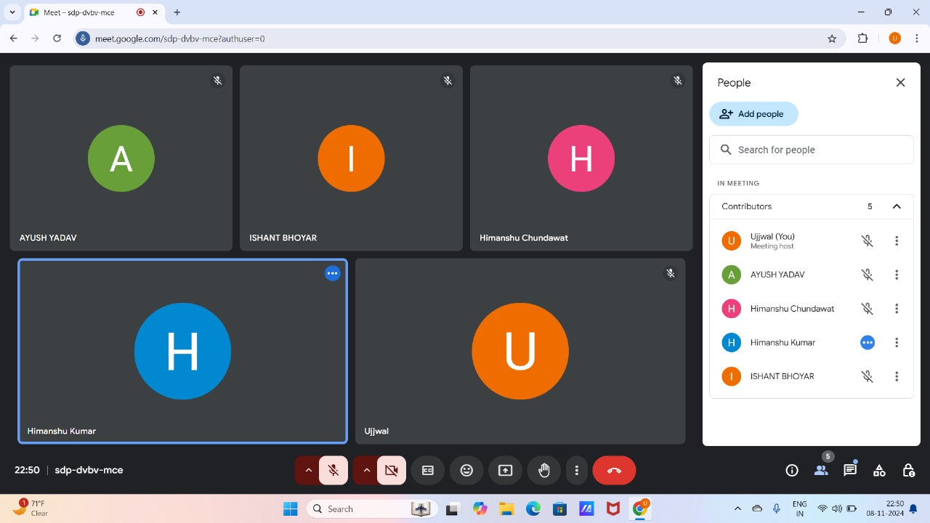

Github- https://github.com/Ujjval-1/LDU_decomposition.git
Content
Project Title
Objective
Our Roles and Responsibilities
Programming Language Used
Team work

Slide 2


OBJECTIVE
To design a web-based LDU factorization
calculator for square matrices.
To provide an interactive tool for simplifying linear algebracomputations and visualizingmatrix factorization.

Slide 3





Our Team Members
UJJVAL BAIJAL
ISHANT BHOYAR
HTML, Tracking Progress
su-24149@sitare.org
GIT-HUB, Documentation
su-24060@sitare.org
HIMANSHU KUMAR
HIMANSHU CHUNDAWAT
CSS, Report of Team
su-24057@sitare.org
CSS, Mentoring the Team
su-24056@sitare.org
AYUSH KUMAR YADAV
HTML
su-24030@sitare.org

Slide 4










LDU FACTORISATION
TEAM WORK
REPORT WORK
Create a ticket in the IT service management
Document the steps taken, changes made, and any additional information relevant to the ticket.
LOWER TRIANGULAR
MATRIX
UPPER TRIANGULAR MATRIX
DIAGONAL MATRIX
A lower triangular matrix has zero elements above the main diagonal in a square matrix.
An upper triangular matrix has zero elements below the main diagonal in a square matrix.
A diagonal matrix has non-zero elements only on the main diagonal, with zeros elsewhere.

Slide 5
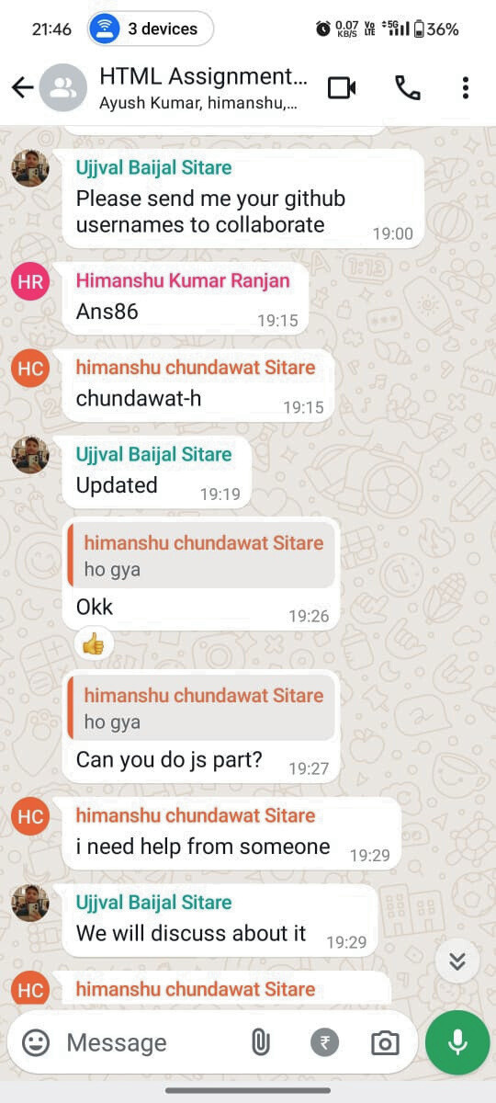
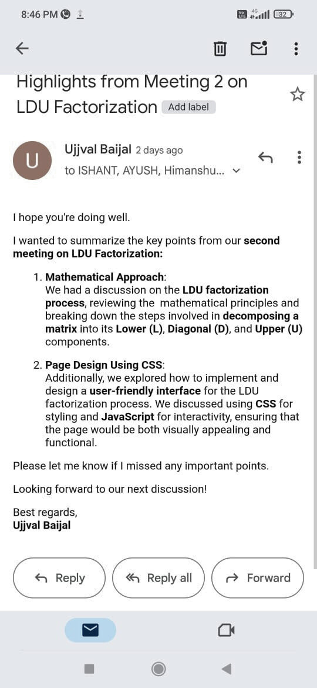

SOME PICTURES FROM OUR WORK
COMPANY NAME
@reallygreatsite
EST. 2020

